Slide 1


Introduction to Blockchain Technology
Blockchain technology is revolutionizing how we store and transfer data. It's a decentralized, transparent system that ensures security and trust. This presentation explores blockchain's core concepts, applications, and its impact on cryptocurrencies.
by Abdul Shafeena

Slide 2





Understanding the Blockchain Ecosystem
Nodes
Miners
Computers in the network that maintain and validate the blockchain.
Participants who solve complex algorithms to add new blocks.
Wallets
Smart Contracts
Digital storage for cryptocurrencies and private keys.
Self-executing contracts with terms directly written into code.

Slide 3

Key Features and Benefits of Blockchain
1
Decentralization
2
Transparency
No single authority controls the network, enhancing security and reducing points of failure.
All transactions are visible to network participants, promoting trust and accountability.
3
Immutability
4
Enhanced Security
Once recorded, data cannot be altered, ensuring the integrity of transaction history.
Cryptographic algorithms protect data from tampering and unauthorized access.

Slide 4
Blockchain Use Cases in Various Industries
Finance
Healthcare
Supply Chain
Cross-border payments, trade finance, and asset tokenization.
Secure patient data management and drug traceability.
Tracking product origin, reducing counterfeits, and improving efficiency.

Slide 5

Blockchain in Cryptocurrencies
1
Bitcoin (2009)
The first decentralized cryptocurrency, introduced blockchain to the world.
2
Ethereum (2015)
Introduced smart contracts, enabling more complex blockchain applications.
3
Modern Cryptocurrencies
Thousands of cryptocurrencies now leverage blockchain for various purposes.

Slide 6
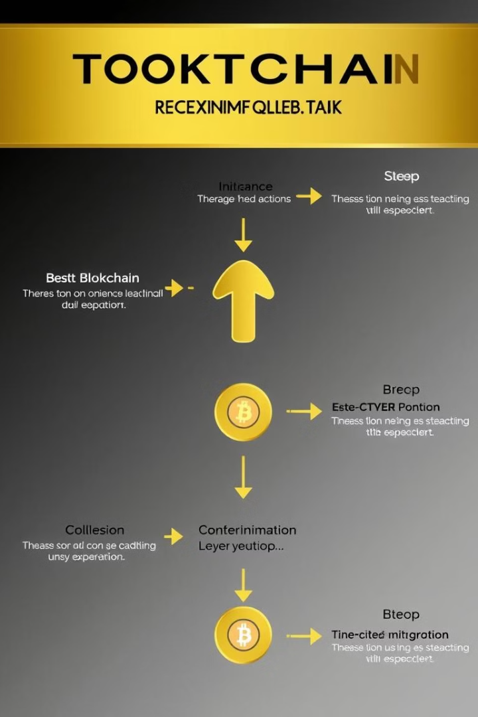




How Blockchain Works in Cryptocurrencies
Transaction Initiation
A user initiates a cryptocurrency transaction.
Block Creation
The transaction is grouped with others into a block.
Block Verification
Miners validate the block through consensus mechanisms.
Block Addition
The verified block is added to the chain, completing the transaction.

Slide 7

Bitcoin: The First Decentralized Cryptocurrency
1
Birth of Bitcoin
Bitcoin was first introduced in 2008 as a peer-to-peer electronic cash system.
2
Decentralization
It operates on a decentralized network, meaning there is no central authority controlling it.
3
Miners
Bitcoin relies on a network of miners who verify transactions and add them to the blockchain.
4
Digital Gold
Bitcoin is often referred to as digital gold due to its limited supply and potential for value storage.

Slide 8
Ethereum: Beyond Bitcoin
Smart Contracts
DApps
Gas Fees
Ethereum allows for the creation of smart contracts, which are self-executing agreements that can automate transactions.
Decentralized applications (dApps) are built on the Ethereum platform, offering new possibilities in various industries.
Transactions on Ethereum require gas fees, which are paid to miners for processing transactions.

Slide 9

The Rise of Cryptocurrencies
Year
Major Event
Impact
2009
Bitcoin Launch
Introduced blockchain-based currency
2013
Bitcoin Price Surge
Increased public awareness
2017
ICO Boom
Rapid growth of new cryptocurrencies
2021
Institutional Adoption
Mainstream acceptance and investment

Slide 10
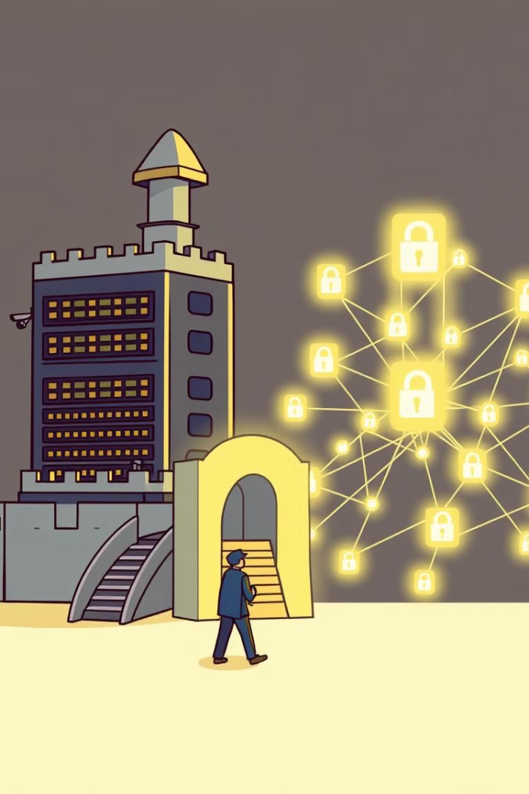
Blockchain vs. Traditional Databases
Blockchain
Traditional Database
Decentralized
Centralized
Immutable
Mutable
Transparent
Opaque
Secure
Vulnerable to hacking

Slide 11

Societal Implications of Blockchain Advancements
1
Financial Inclusion
2
Supply Chain Transparency
Blockchain can provide access to financial services for underserved populations.
Blockchain can improve supply chain transparency and traceability.
3
Data Security
4
Government Efficiency
Blockchain offers enhanced data security and privacy.
Blockchain can streamline government processes and reduce corruption.

Slide 12

Future Trends and Opportunities in Blockchain
Interoperability
Sustainability
Increasing connectivity between different blockchain networks, enabling seamless data and value transfer.
Development of energy-efficient consensus mechanisms to address environmental concerns.
Tokenization
Regulatory Clarity
Broader adoption of asset tokenization, revolutionizing ownership and trading of real-world assets.
Establishment of clearer regulatory frameworks, fostering wider institutional and corporate adoption.

Slide 13
Advantages and Disadvantages of Blockchain
Advantages
Disadvantages
Enhanced security
Scalability issues
Transparency
High energy consumption
Decentralization
Regulatory uncertainty
Efficiency
Complexity for users

Slide 14

Conclusion on Blockchain
1
Transformative Technology
2
Ongoing Evolution
3
Wide-Ranging Impact
Continuous innovation is addressing current limitations and expanding blockchain's potential.
From finance to supply chains, blockchain's influence will continue to grow.
Blockchain is reshaping industries and redefining trust in digital transactions.

